Slide 1
POWER SYSTEM FAULT DETECTION AND CLASSIFICATION USING MACHINE LEARNING
CAPSTONE PROJECT
Presented By:
1. Vivek Chaurasia- CoochBehar Government Engineering College-CSE

Slide 2
OUTLINE
Problem Statement (Should not include solution)
Proposed System/Solution
System Development Approach (Technology Used)
Algorithm & Deployment
Result (Output Image)
Conclusion
Future Scope
References

Slide 3
Problem Statement
Power distribution systems are prone to various faults such as line-to-ground, line-to-line, and three-phase faults, which can disrupt grid stability and reliability. This project aims to develop a machine learning model that can detect and classify these faults using electrical measurement data. The challenge is to ensure accurate and real-time fault detection using complex input data (e.g., voltage and current phasors). Automating fault diagnosis with ML techniques can enhance system response, reduce downtime, and improve overall grid performance.

Slide 4
Proposed Solution
Design a machine learning model capable of identifying and categorizing power system faults based on the given dataset. The model will analyze electrical signals to swiftly and accurately detect fault types. This intelligent classification will streamline fault detection and support faster system recovery, enhancing overall grid reliability.
Key components:
Data Acquisition: Utilize a publicly available dataset (e.g., from Kaggle) containing labeled power system fault scenarios.
Data Preparation: Preprocess the data by cleaning, scaling, and transforming it into suitable input formats.
Model Development: Implement and train classification algorithms such as Decision Tree, Random Forest, or Support Vector Machine (SVM).
Performance Assessment: Evaluate the model using metrics like accuracy, precision, recall, and F1-score to ensure its effectiveness.

Slide 5
System Approach
The "System Approach" section outlines the overall framework and tools used for developing and deploying the machine learning model for fault detection in power systems. Below are the system requirements:
System requirements:
IBM Cloud (required for deployment)
IBM Watson Studio for model development and deployment
IBM Cloud Object Storage for managing and accessing datasets

Slide 6
Algorithm & Deployment
Algorithm Selection: Random Forest Classifier (or SVM, depending on model performance)
Data Input: Voltage, current, and phasor measurements extracted from the dataset
Training Process: Supervised learning approach using labeled fault data for model training
Prediction Process: Deploy the trained model on IBM Watson Studio using API endpoints for real-time fault classification

Slide 7
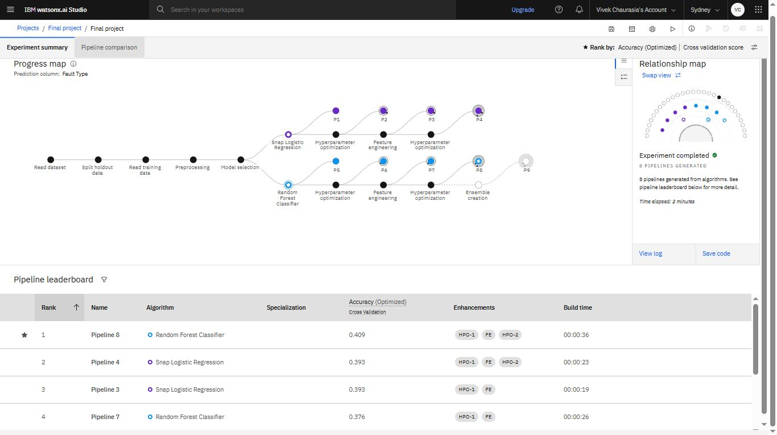
Result

Slide 8
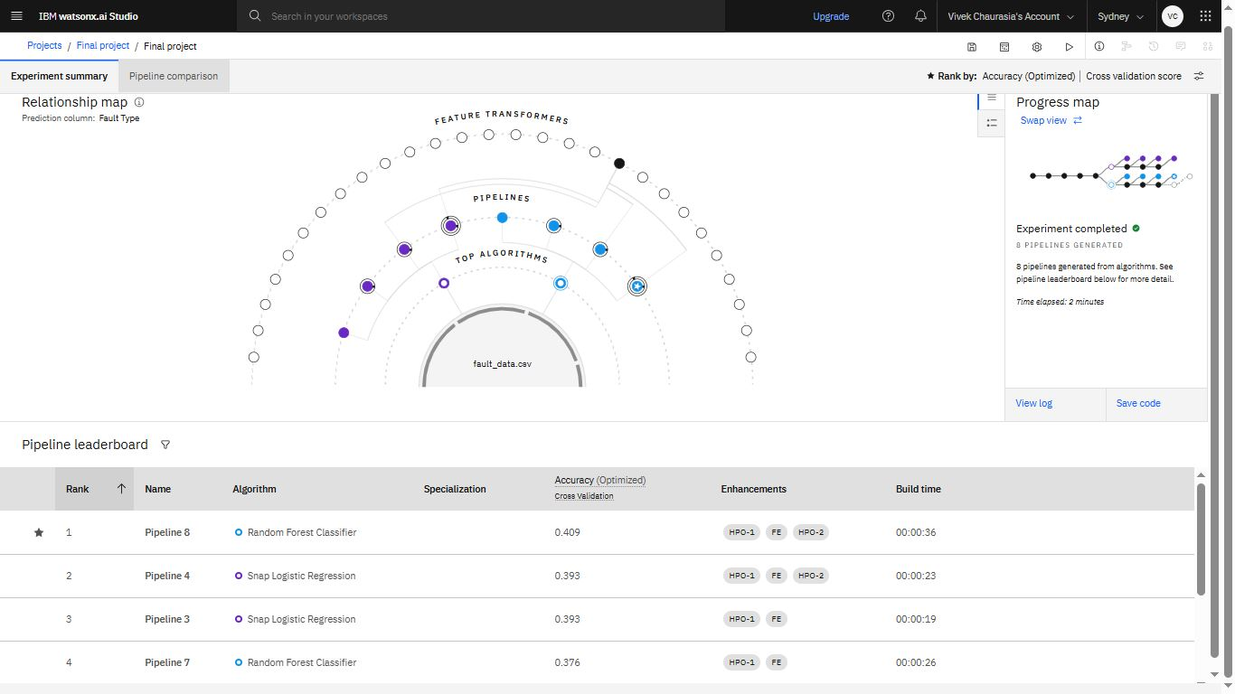
Result

Slide 9
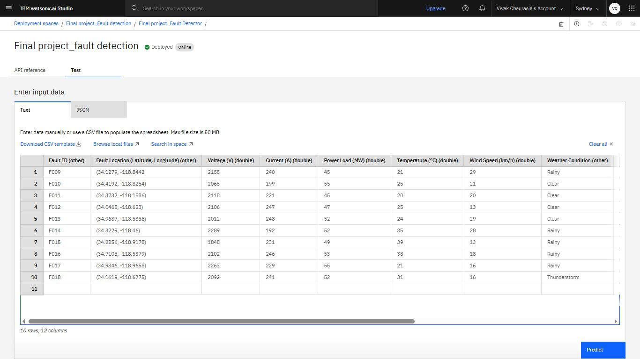
Result

Slide 10
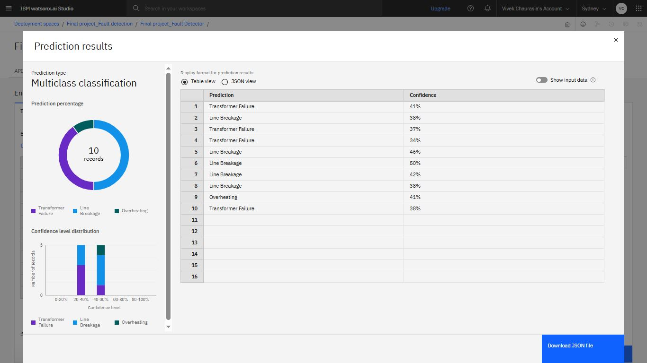
Result

Slide 11
Conclusion
The implementation of a machine learning model for fault detection and classification in power distribution systems enhances the speed and accuracy of identifying faults such as line-to-ground, line-to-line, and three-phase disturbances. By leveraging IBM Cloud tools like Watson Studio and Object Storage, the solution ensures efficient data handling, model training, and real-time prediction. This automated approach not only improves grid reliability but also minimizes downtime and supports quicker decision-making for fault management.

Slide 12
Future scope
Algorithm Optimization: Fine-tune hyperparameters, implement feature selection techniques, and experiment with ensemble models or hybrid approaches to enhance prediction speed and accuracy.
Geographical Expansion: Scale the system to monitor power grids across multiple cities or regions by building a distributed model that adapts to location-specific grid behavior and fault types.
Edge Computing Integration: Deploy models on edge devices close to substations or transformers, allowing for low-latency fault detection and reducing dependence on central cloud servers.
Advanced Machine Learning Techniques: Utilize deep learning models like Convolutional Neural Networks (CNN) for waveform analysis and Long Short-Term Memory (LSTM) networks for temporal fault pattern recognition.

Slide 13
References
IBM Cloud – https://www.ibm.com/cloud/
IBM Watson Studio – https://www.ibm.com/cloud/watson-studio
Kaggle Datasets – https://www.kaggle.com/

Slide 14
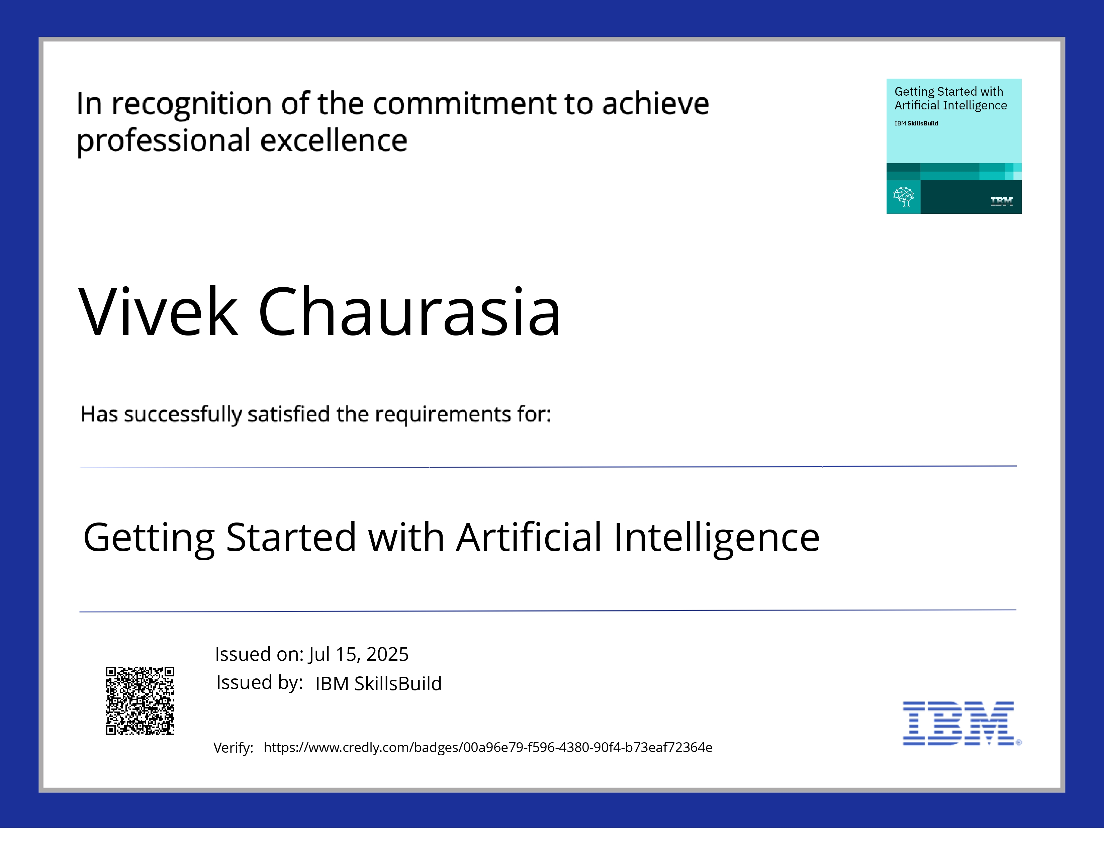
IBM Certifications

Slide 15
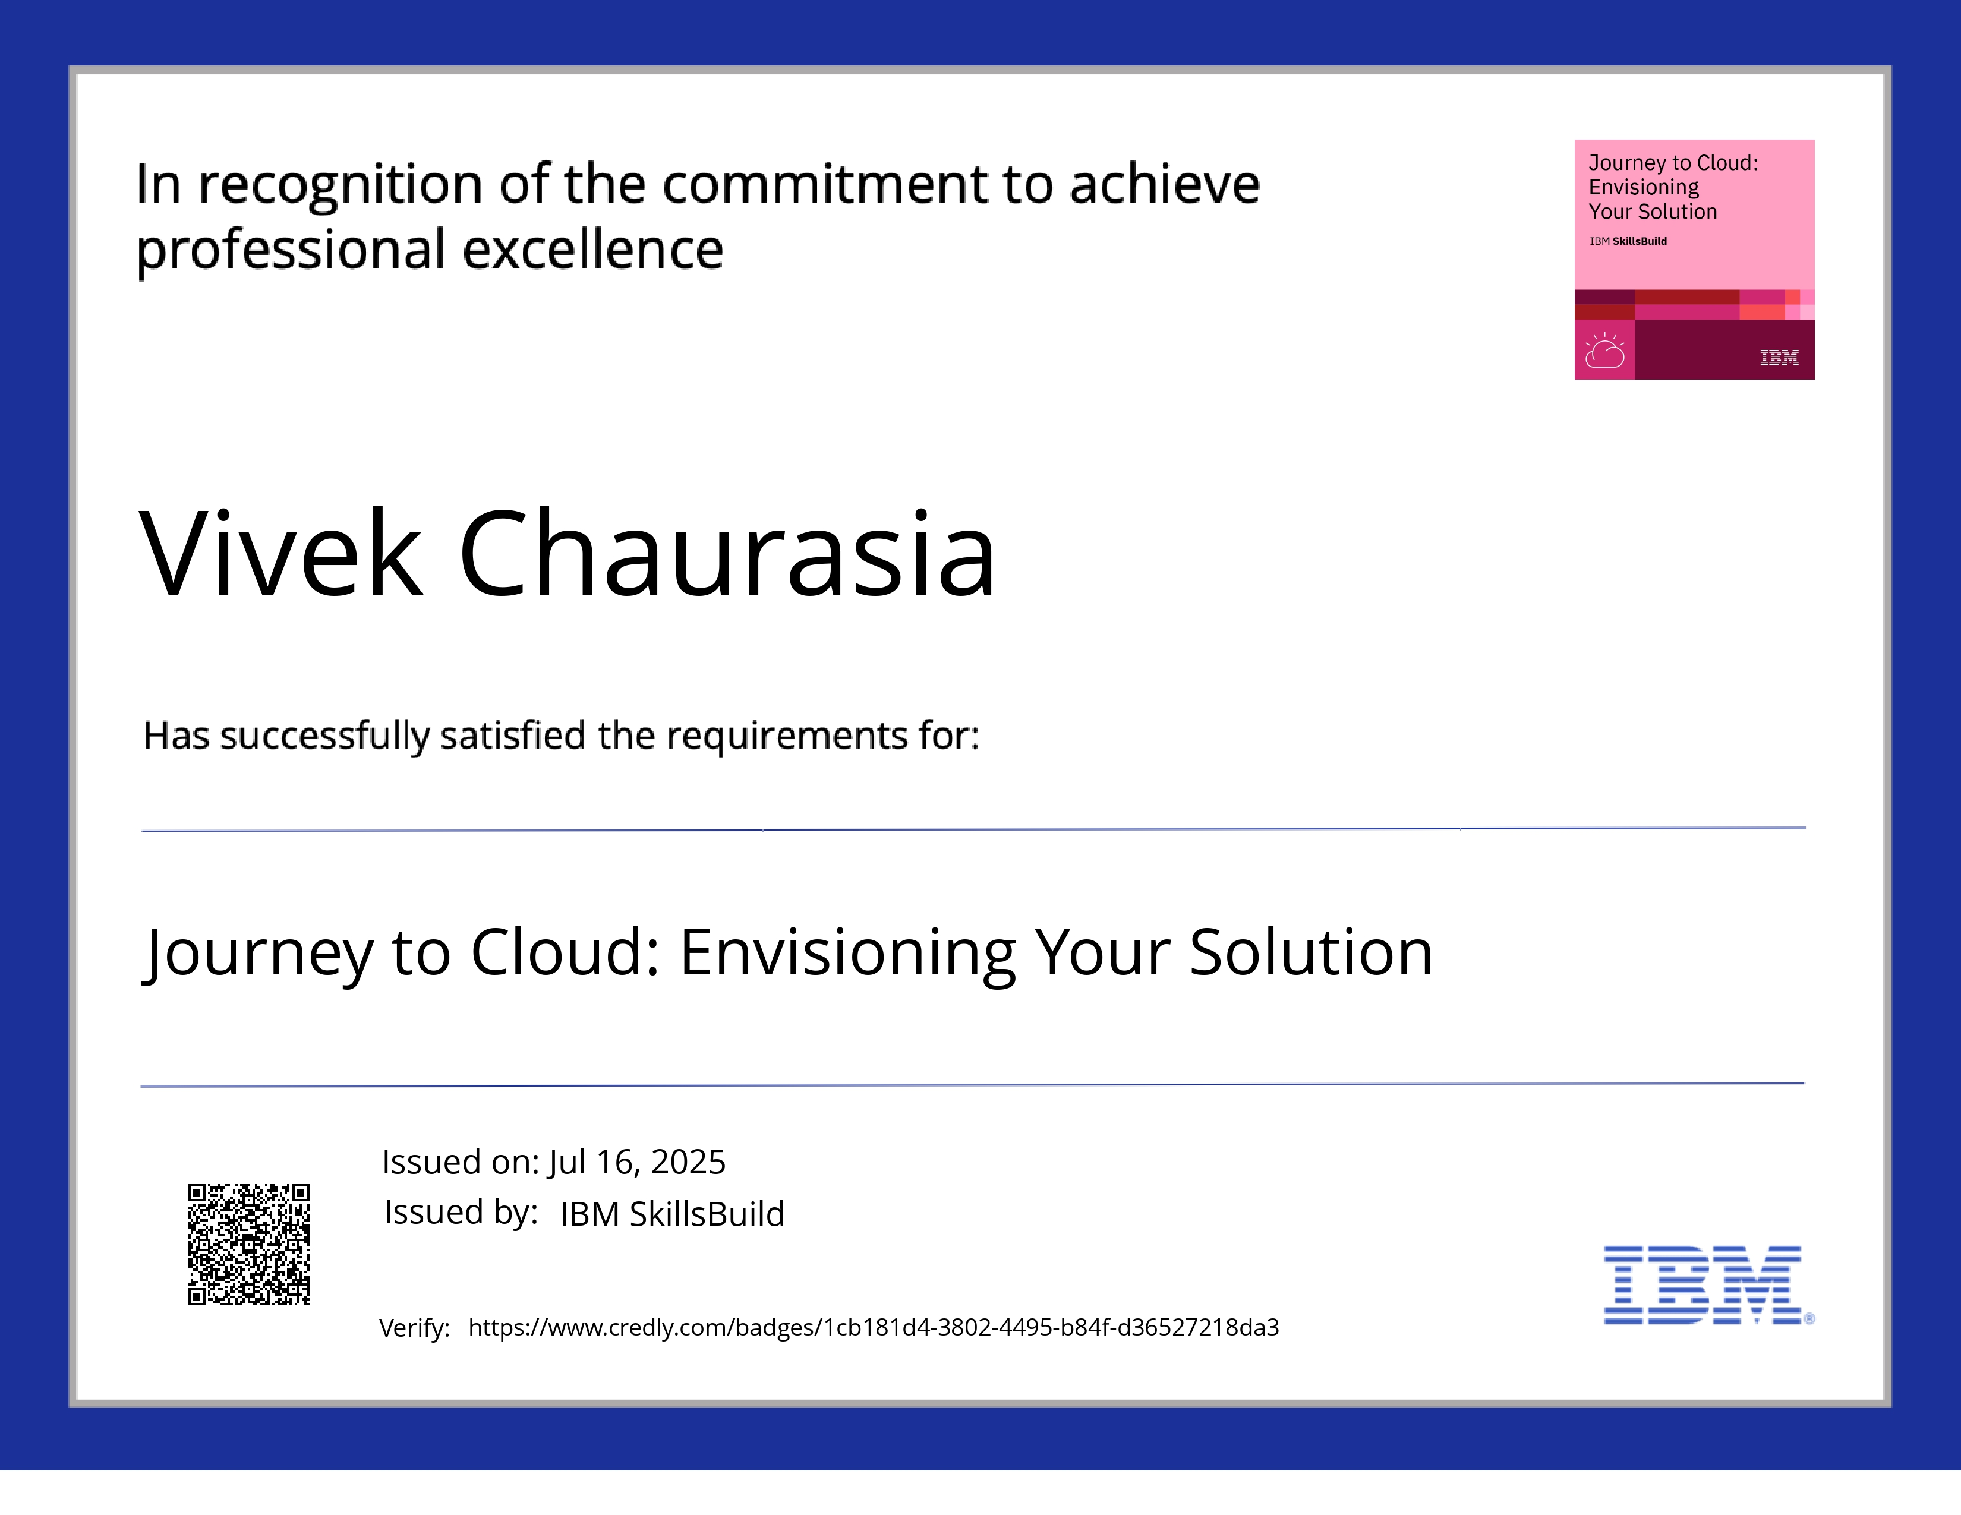
IBM Certifications

Slide 16
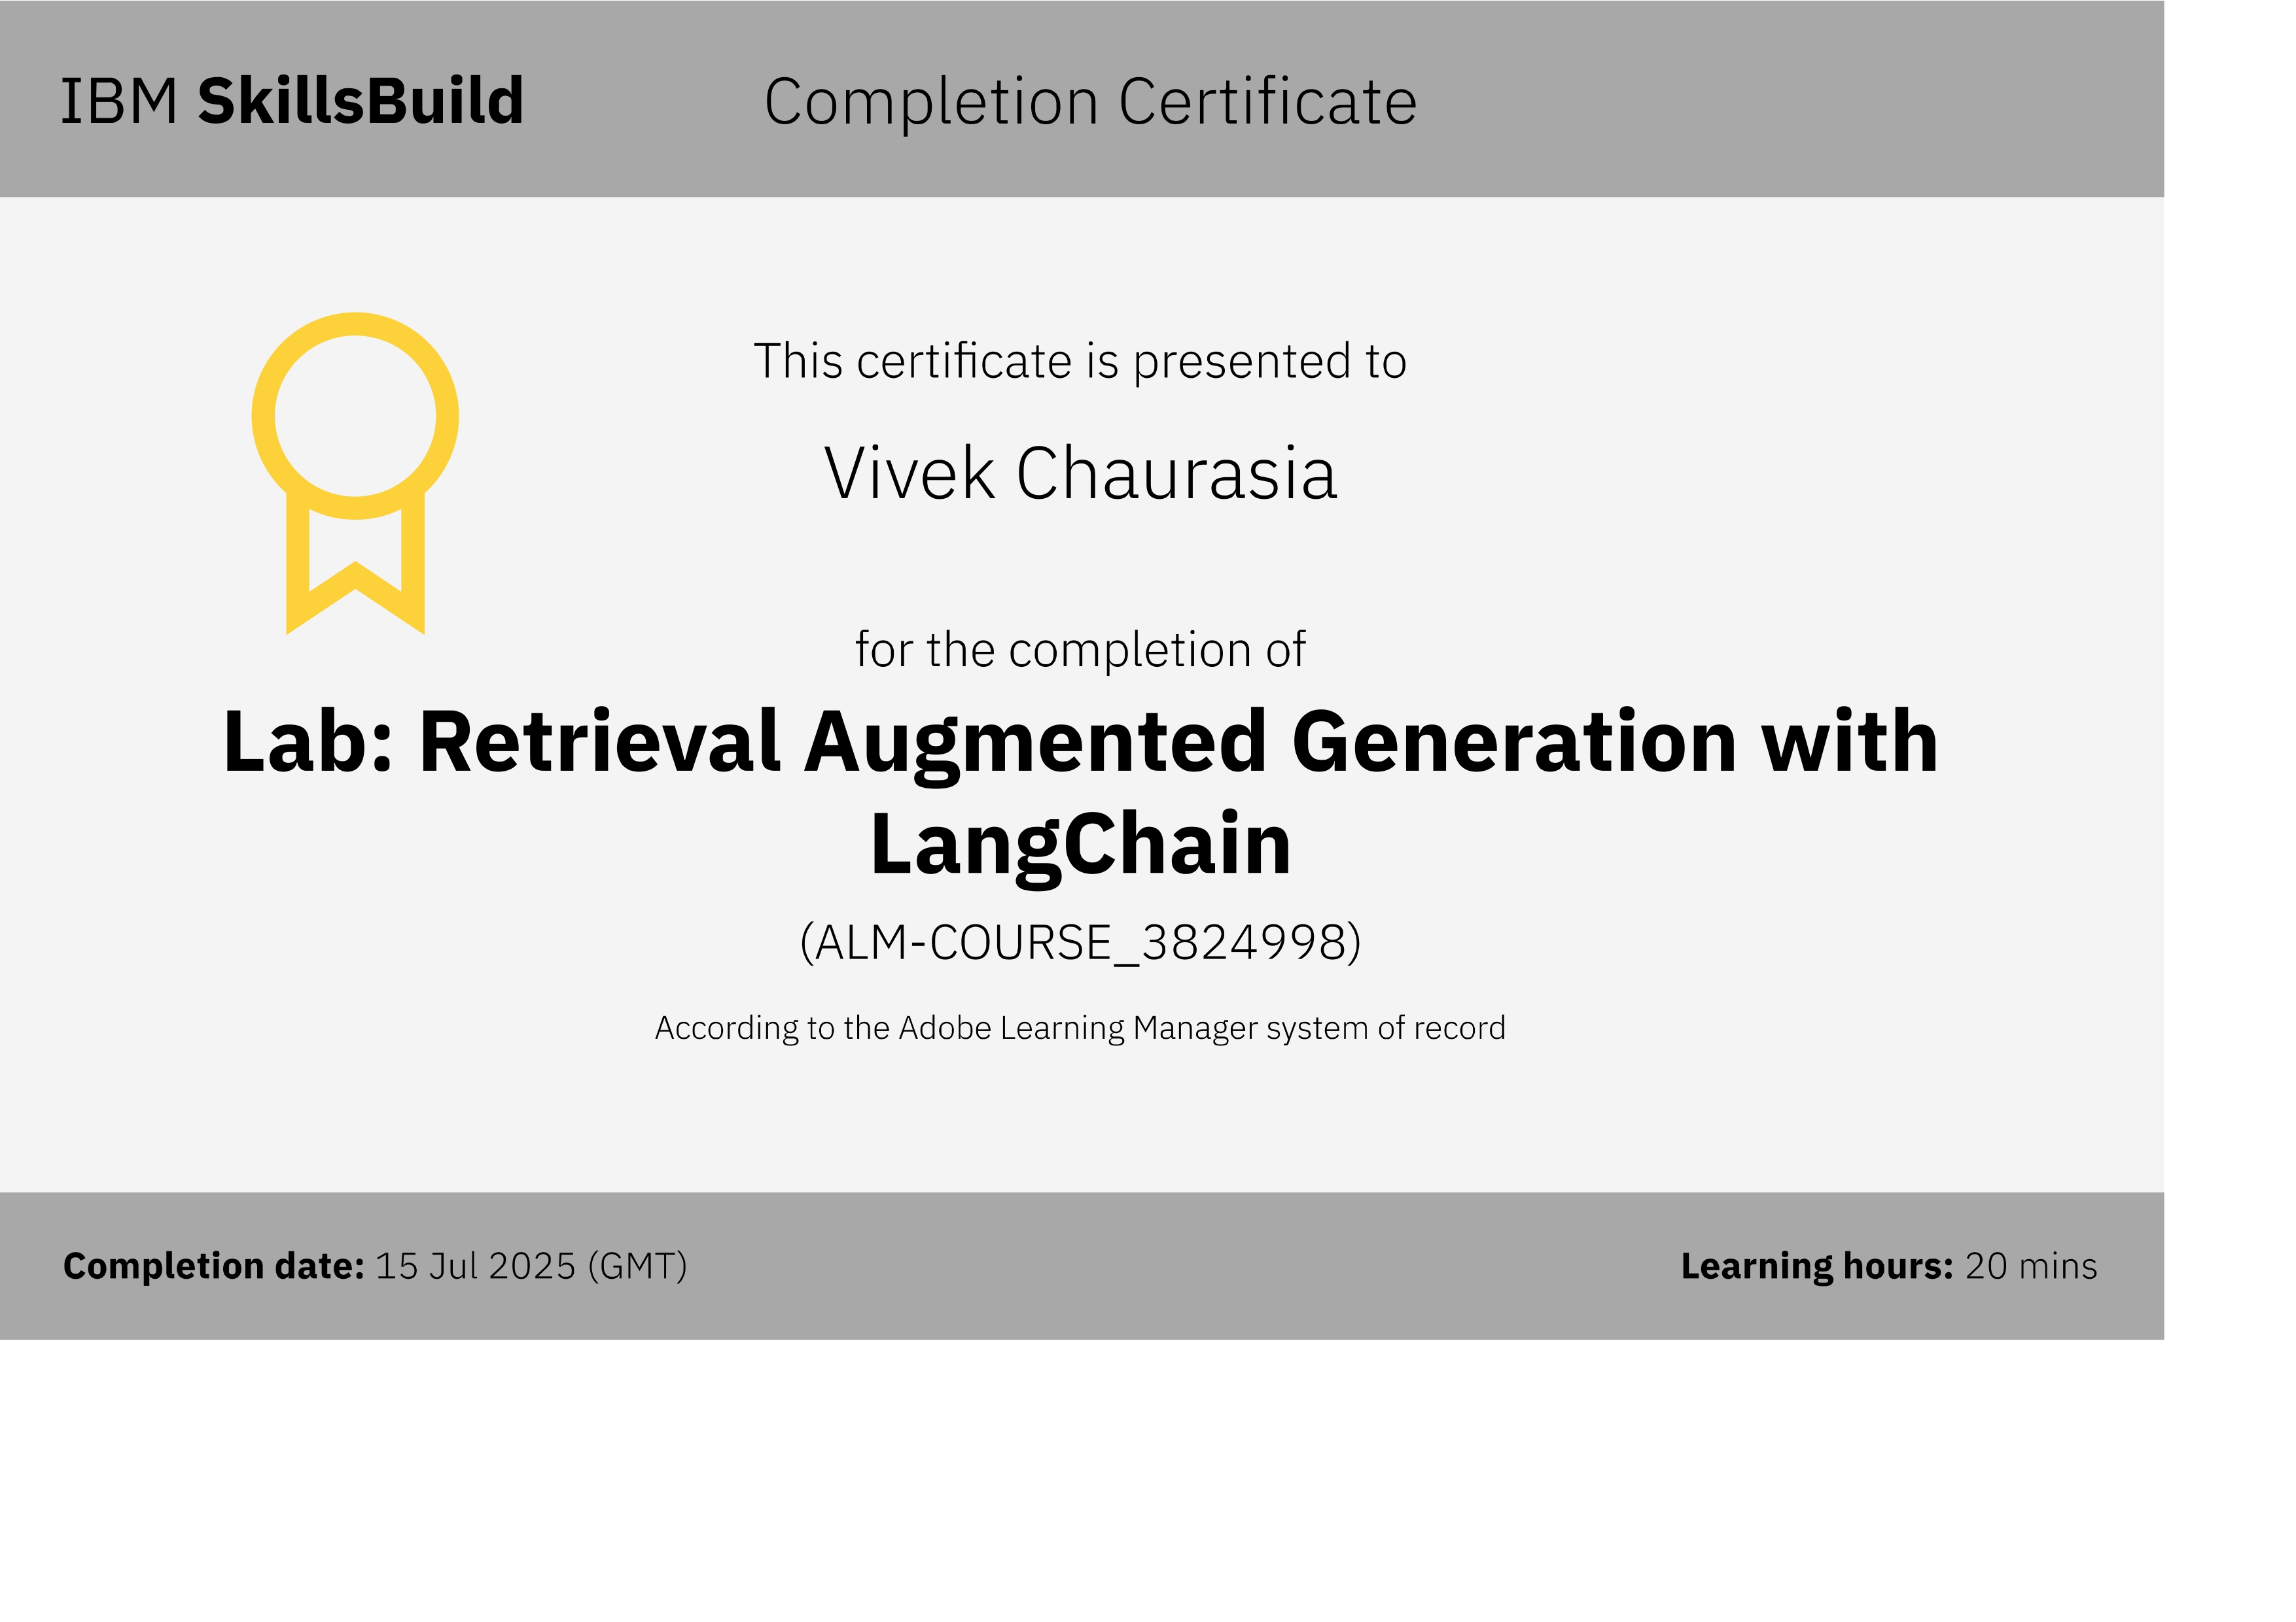
IBM Certifications

Slide 17
THANK YOU

